Slide 1





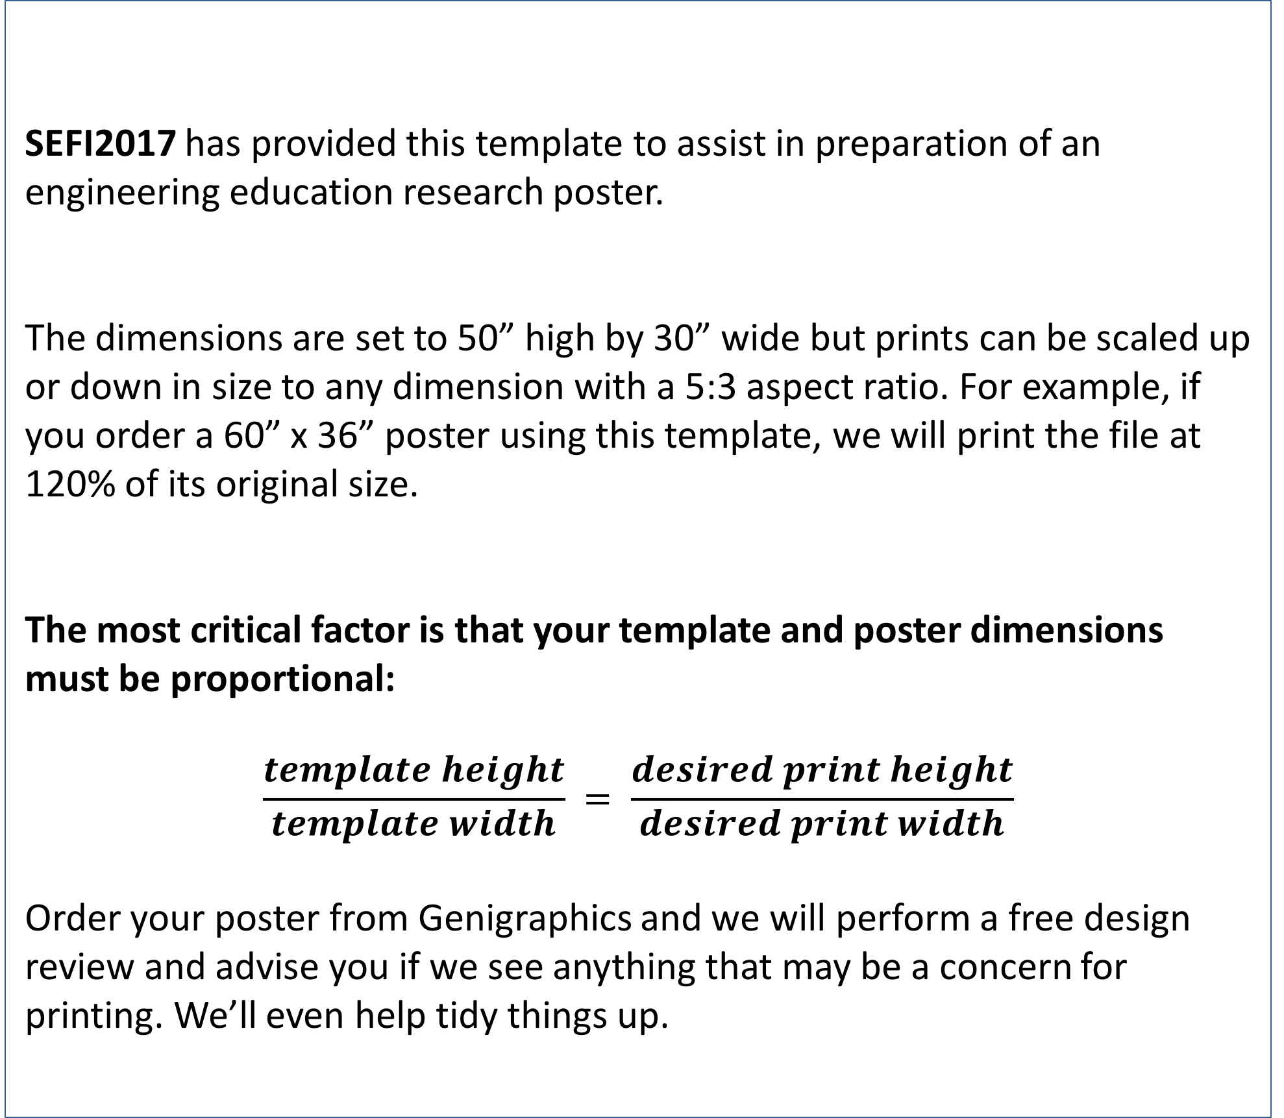
Template Provided By SEFI 2017 Conference
Replace This Text With Your Title
REPLACE THIS BOX WITH YOUR ORGANIZATION’S
HIGH RESOLUTION LOGO
John Smith, MD¹; Jane Doe, PhD²; Frederick Jones, MD, PhD^{1,2}
¹University of Affiliation, ²Research Center of Affiliation
Abstract
Results
Click here to insert your Abstract text. Type it in or copy and paste from your Word document or other source.
This text box will automatically re-size to your text. To turn off that feature, right click inside this box and go to Format Shape, Text Box, Autofit, and select the “Do Not Autofit” radio button.
To change the font style of this text box: Click on the border once to highlight the entire text box, then select a different font or font size that suits you. This text is Calibri 30pt, which is effectively 36pt at 120%, and is easily read up to 5 feet away on a 60x36 poster.
Zoom out to 120% to preview what this will look like on your printed poster.
Click here to insert your Results text. Type it in or copy and paste from your Word document or other source.
This text box will automatically re-size to your text. To turn off that feature, right click inside this box and go to Format Shape, Text Box, Autofit, and select the “Do Not Autofit” radio button.
To change the font style of this text box: Click on the border once to highlight the entire text box, then select a different font or font size that suits you. This text is Calibri 30pt, which is effectively 36pt at 120%, and is easily read up to 5 feet away on a 60x36 poster.
Zoom out to 120% to preview what this will look like on your printed poster.
Speaking of Results, yours will look better if you remember to run a spell-check on your poster! After you’ve added your content click on Review, Spelling, or press F7.
Introduction
SEFI2017 has provided this template to assist in preparation of an engineering education research poster.
The dimensions are set to 50” high by 30” wide but prints can be scaled up or down in size to any dimension with a 5:3 aspect ratio. For example, if you order a 60” x 36” poster using this template, we will print the file at 120% of its original size.
The most critical factor is that your template and poster dimensions must be proportional:
$$\frac{template height}{template width} = \frac{desired print height}{desired print width}$$
Order your poster from Genigraphics and we will perform a free design review and advise you if we see anything that may be a concern for printing. We’ll even help tidy things up.
Chart 1. Label in 20pt Calibri.
Discussion
Click here to insert your Discussion text. Type it in or copy and paste from your Word document or other source.
This text box will automatically re-size to your text. To turn off that feature, right click inside this box and go to Format Shape, Text Box, Autofit, and select the “Do Not Autofit” radio button.
To change the font style of this text box: Click on the border once to highlight the entire text box, then select a different font or font size that suits you. This text is Calibri 30pt, which is effectively 36pt at 120%, and is easily read up to 5 feet away on a 60x36 poster.
Zoom out to 120% to preview what this will look like on your printed poster.
Methods and Materials
Click here to insert your Methods and Materials text. Type it in or copy and paste from your Word document or other source.
This text box will automatically re-size to your text. To turn off that feature, right click inside this box and go to Format Shape, Text Box, Autofit, and select the “Do Not Autofit” radio button.
To change the font style of this text box: Click on the border once to highlight the entire text box, then select a different font or font size that suits you. This text is Calibri 30pt, which is effectively 36pt at 120%, and is easily read up to 5 feet away on a 60x36 poster.
Zoom out to 120% to preview what this will look like on your printed poster.
Table 1. Label in 20pt Calibri.
Figure 1. Label in 20pt Calibri.
Figure 2. Label in 20pt Calibri.
Figure 3. Label in 20pt Calibri.
 | Heading | Heading | Heading
Item | 800 | 790 | 4001
Item | 356 | 856 | 290
Item | 228 | 134 | 238
Item | 954 | 875 | 976
Item | 324 | 325 | 301
Conclusions
Click here to insert your Conclusions text. Type it in or copy and paste from your Word document or other source.
This text box will automatically re-size to your text. To turn off that feature, right click inside this box and go to Format Shape, Text Box, Autofit, and select the “Do Not Autofit” radio button.
Contact
References
<your name>
<your organization>
Email:
Website:
Phone:

